Slide 1
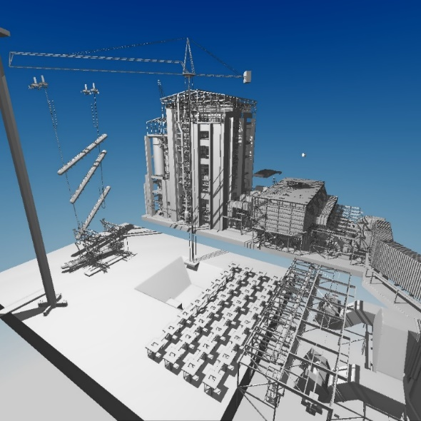
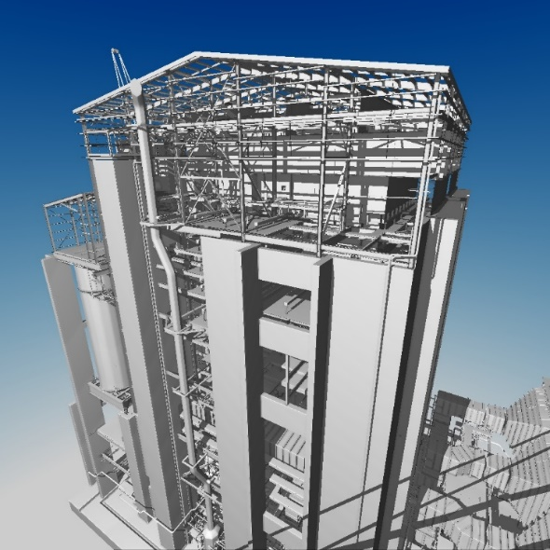
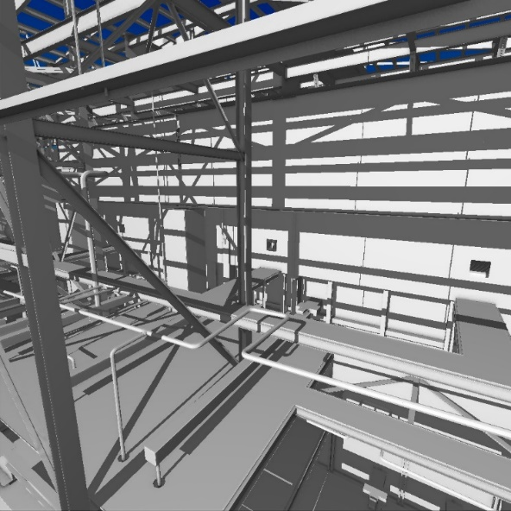
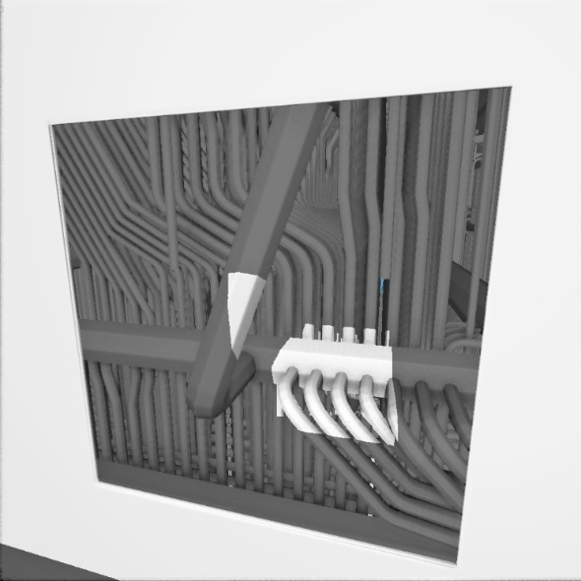


Voxel DAGs and Multiresolution Hierarchies
From Large-Scale Scenes to Pre-computed Shadows
Advanced DAG encodings
Alberto Jaspe Villanueva
ajaspe@crs4.it
CRS4 :: Visual Computing
http://vic.crs4.it
This work was financed by

Slide 2
Focus
How to further increase compression rates of geometric data by exploiting symmetries in addition to replication
How to efficiently encode geometric data by exploiting the skewed distribution of references to shared nodes
How to achieve this with still an efficient traversal
(Just geometry. For attribute compression, next talk! )

Slide 3
Related Work
Very hot topic with lots of contributions, not only DAGs
  Voxelization
  [Crassin and Green, 2012] [Pätzold and Kolb, 2015] …
  Voxelized representation and render
  [Laine and Karras, 2011 & 2012] [Crassin et al. 2009, 2012] [Schnabel and Klein, 2006] …
  Trees encoding & hashing
  [Lefevre and Hoppe, 2011] [Duan et al. 2017] …
  Volume compression surveys
  [Beyer et al. 2015] [Balsa et al. 2013] …
Symmetry-aware compression
[Jaspe et al. 2016, 2017]
Entropy encoding
[Jaspe et al. 2016, 2017] [Dado et al. 2016] [Kampe et al. 2016] …

Slide 4

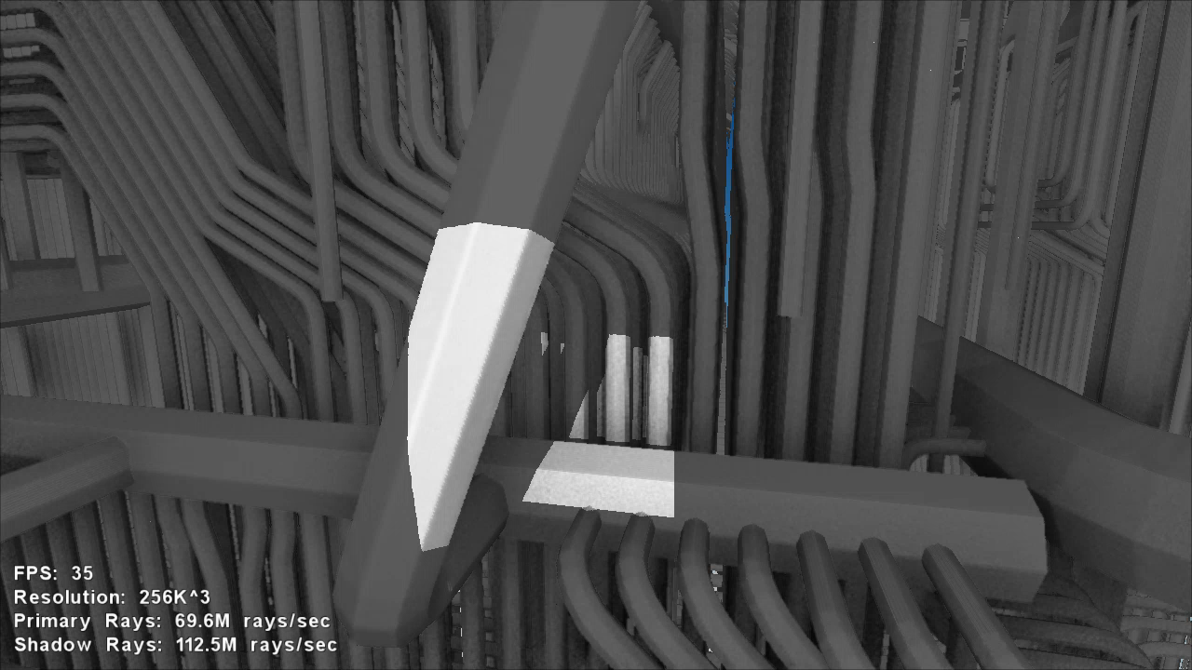
SSVDAGs
Symmetry-aware
loseless voxel structure
Compact GPU-friendly encoding
Build and traversal methods
Advantages
  ~ 50% more compact
  Similar tracing speed
  Able to build massive models

Slide 5
Quick recap – Sparse Voxel Octrees (SVO)
Introduce sparsity in a full-octree
  Compression by avoiding to encode empty space
  Grows quadratically with resolution
  Very fast traversal methods
Encoding requires 1 pointer per node

Slide 6
Quick recap – Sparse Voxel DAG (SVDAG)
Avoiding multiple encodings of same subtrees [Kämpe et al. 2013]
  Tree becomes a directed graph
  Same traveral method as SVOs
Up to x100 or more reduced number of nodes SVOs
Encoding requires 1 pointer per each node child

Slide 7
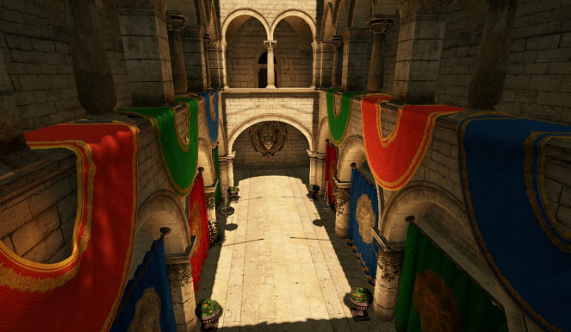
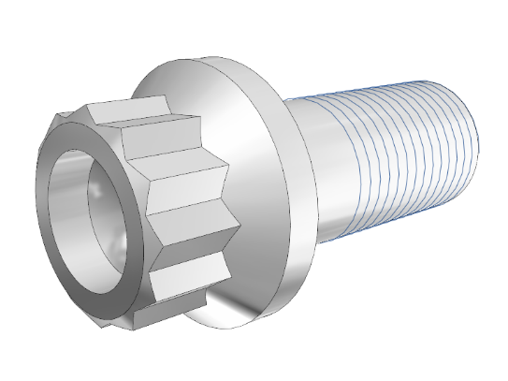
SSVDAGs approach
Reduce number of nodes by merging subtrees equal up to a similarity transform
A ≠ B
T(A)
A
B
A
T(A) = B
:
:
:
Chosen transform: Reflection Symmetries
  Geometric meaning
  Expected in real-world scenes

Slide 8










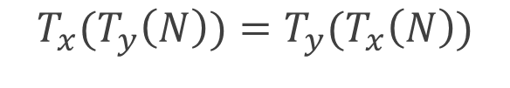


Reflection Symmetries
Mirror transform along main 3 planes
  Pointer tag is encoded with only 3 bits (X,Y,Z)
Useful properties for building and traversing
  Order of application does not matter
  Cyclic (applying just means inverting the tag)
$$y$$
$$T_{xy}$$
$$xy$$
$$T_{y}$$
$$T_{x}$$
$$T_{y}$$
$$T_{x}(T_{y}\left(N\right))=T_{y}(T_{x}\left(N\right))$$
$$T_{y}$$
$$T_{x}$$
$$xy$$
$$yz$$
$$T_{xz}$$
$$T_{x}(T_{x}\left(N\right))=N$$

Slide 9
Reflection Symmetries
Invariants
T_{x}
T_{y}
T_{y}
T_{x,y}
T_{x}
Canonical base
T_{x,y}
T_{x,y}
T_{x}
T_{y}
T_{x}
T_{y}
T_{y}
T_{x}
T_{y}
T_{x}
2D canonical base: 7 nodes / 16
3D canonical base: 46 nodes / 256

Slide 10
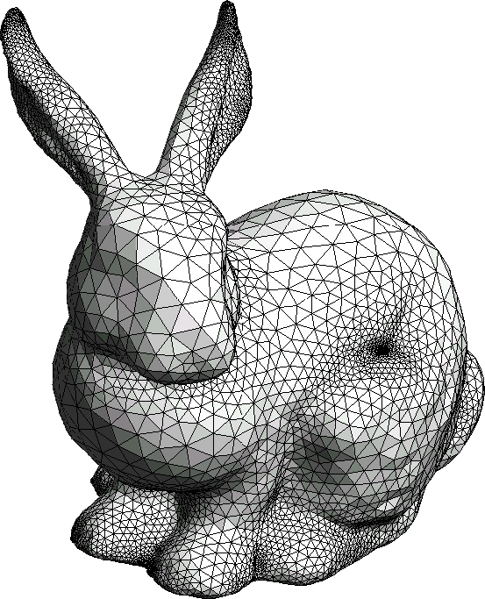
SSVDAGs Building
Bottom–up process
One pass per level: sort – transform – match – merge
Additional data respect to DAG construction
  Invariant masks: 3 bits per node (only during building)
  Transformation tags: 3 bits per pointer
Implementations
  Out-of-core: memory-mapped, external-memory arrays (whole levels)
  In-core: partitioning in memory-fitting subtrees and reduction
Mesh
DAG
voxelization
Octree / SVO
SSVDAG

Slide 11
Building process – Leaves level
Symmetry detected just using the voxel bit mask
  1. Look for every leaf to its canonical form
  2. Remap and tag pointers with its transformation
  3. Mark invariants

Slide 12

Building process – Example
Symmetry detected just using the voxel bit mask
  1. Look for every leaf to its canonical form
  2. Remap and tag pointers with its transformation
  3. Mark invariants
x
y
y
$$i_{x}$$

Slide 13
Building process – Inner Levels
Search for symmetries in the whole subtree,
without checking down to the leaves

Slide 14
Building process – Inner Levels
  1. Sort & cluster nodes, using keys of sorted pointers
  2. For each cluster
  For each one of the 8 combinations of transformations
  Transform and match nodes
Level N-1
Level N
Level N+1

Slide 15

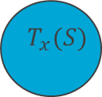

Building process – Inner Levels
  1. Sort & cluster nodes, using keys of sorted pointers
  2. For each cluster
  For each one of the 8 combinations of transformations
  Transform and match nodes
$$T_{x}(S)$$
$$T_{x}$$
T_{x}(t₂)
T_{x}(t₃)
$$S$$
2
T_{x}(t₁)
T_{x}(t₄)
3
t₁
t₄
1
4
1
2
t₂
t₃
1
4
3
4
2
3

Slide 16
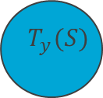




Building process – Inner Levels
  1. Sort & cluster nodes, using keys of sorted pointers
  2. For each cluster
  For each one of the 8 combinations of transformations
  Transform and match nodes
$$T_{x}(S)$$
$$T_{x}$$
T_{x}(t₂)
T_{x}(t₃)
$$S$$
2
T_{x}(t₁)
T_{x}(t₄)
3
t₁
t₄
1
4
1
2
t₂
t₃
$$T_{y}$$
3
4
$$T_{y}(S)$$
1
4
2
3
T_{y}(t₃)
T_{y}(t₂)
3
T_{y}(t₄)
T_{y}(t₁)
2
4
1

Slide 17



Building process – Inner Levels
  1. Sort & cluster nodes, using keys of sorted pointers
  2. For each cluster
  For each one of the 8 combinations of transformations
  Transform and match nodes
  For each child pointer
  Check if both are equal
  If pointed node is not invariant,
  check transformation tag
$$S$$
$$S′$$
t₁
t₄
t'₁
t’₄
t₂
t₃
t’₂
t’₃
1
4
1’
4’
2
3
2’
3’
${(i}_{x,y,z}$)

Slide 18
Building process – Inner Levels
  1. Sort & cluster nodes, using keys of sorted pointers
  2. For each cluster
  For each one of the 8 combinations of transformations
  Transform and match nodes
  3. Merge matches and update pointers from upper level
Level N-1
t
t
Level N
Level N+1

Slide 19


Building process – Inner Levels
  1. Sort & cluster nodes, using keys of sorted pointers
  2. For each cluster
  For each one of the 8 combinations of transformations
  Transform and match nodes
  3. Merge matches and update pointers from upper level
  4. Update invariants
Level N-1
Level N-1
$$i_{t}$$
t
t
Level N
Level N
$$i_{t}$$
Level N+1
Level N+1

Slide 20



Building process – Example
$$T_{x}$$
Match!
x
x
x
2
1
2
2
1($i_{x}$)
1
x
x
y
y
$$i_{x}$$
(1)
(2)

Slide 21

Building process – Example
$$T_{xy}$$
Match!
x
x
x
y
2
y
2
1($i_{x}$)
1
2
1
xy
x
x
y
y
$$i_{x}$$
(1)
(2)

Slide 22
Building process – Example
SVO (10 nodes)
SVDAG (9 nodes)
xy
x
x
SSVDAG (4 nodes)
$$i_{x}$$
(1)
(2)

Slide 23
Compact encoding
Goal: minimize size with minimum performance impact
Every pointer must be tagged (XYZ reflection bits)
GPU-friendly memory layout
Steps
  Leaf grouping
  Frequency-based pointers compaction
  Variable bitrate memory alignment

Slide 24
Compact encoding
Leaf grouping
  2³ leaves good for construction
  4³ leaves better for encoding and traversal speed
V.S.
Fixed 8 bytes
Min 1 child: 32bits + 8bits = 5 bytes
Max 8 children: 8 * (32bits + 8 bits) = 40 bytes

Slide 25
Compact encoding
Frequency-based pointer compaction
  Distribution of references to nodes highly skewed
Power Plant 64k³

Slide 26
Compact encoding
Frequency-based pointer compaction
  Distribution of references to nodes highly skewed
  Sort nodes by nº references
Variable index size
  [1 .. 8K] : 13bits
  [8K .. 527M] : 29 bits
  [527M .. 1,074M] : 30 bits
Shortest indices
Longest indices

Slide 27
Compact encoding
Leaves nodes
encoding
Inner nodes encoding
node
children bitmask
16-bits
alignment
00
01
00
10
00
11
00
00
00 | No child
01 | 13 bits pointer child
10 | 29 bits pointer child
11 | 30 bits pointer child
64 bits
4³ leaf
reflection bits
13 bits pointer
x
y
z
reflection bits
29 bits pointer
x
y
z
64 bits
4³ leaf
Total node size
Min: 4 bytes (1 “13-bits” child)
Max: 34 bytes (8 “30-bits” children)
reflection bits
30 bits pointer
(1st bit = 1)
x
y
z

Slide 28


Traversal / Ray-casting
Same as for SVOs/DAGs but need to keep track of transformation upon descent in the tree
  Transformation state: 3 bits [x,y,z]
  When traverse new node: XOR with pointer’s tag
Using the stacked transform
  Remap children indices, one bitwise operation
      transformedIdx = currentTransform XOR selectedChildIdx
  Transform the ray
    Reflect ray’s origin (voxel entry point)
    Inverse direction
$$T_{x}$$
$$T_{xy}$$

Slide 29

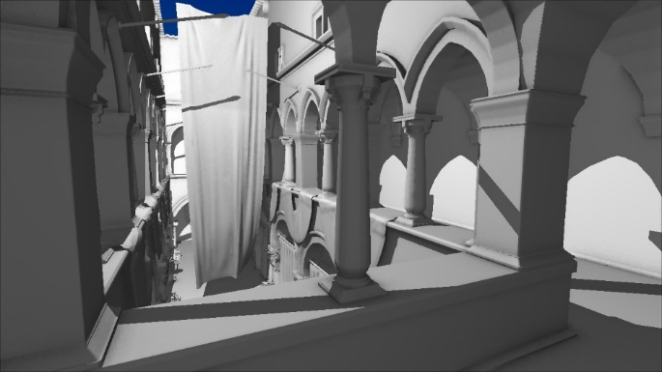
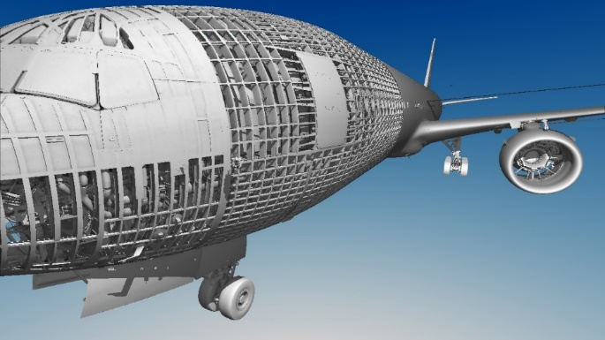

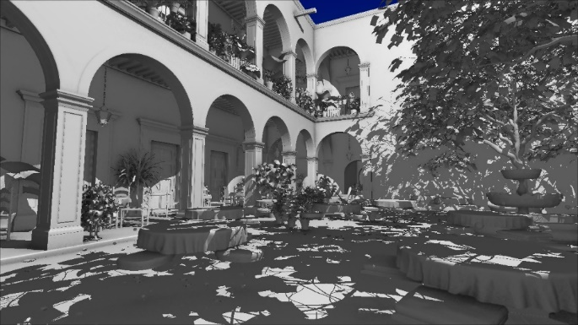
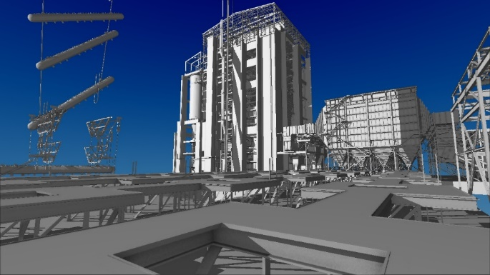
Results – Datasets
Scanned scenes
Gaming scenes
CAD scenes
Lucy (28 Mtris)
Crytek Sponza (282 Ktris)
Boeing 777 (350 Mtris)
David (56 Mtris)
San Miguel (7.8 Mtris)
Power Plant (12 Mtris)

Slide 30
Results – Compression performance (64k³)

Slide 31
Results – Compression performance
Average node reduction only by symmetries: ~21%
Average data memory size reduction only by encoding: ~23%
Together, they achieve a data reduction average of 52.4%
  Symmetries favor pointer compaction
Conversion time performance not aimed for real-time
  Few seconds for lowest resolutions (2k³, 4k³, 8k³)
  Up to few minutes for biggest

Slide 32
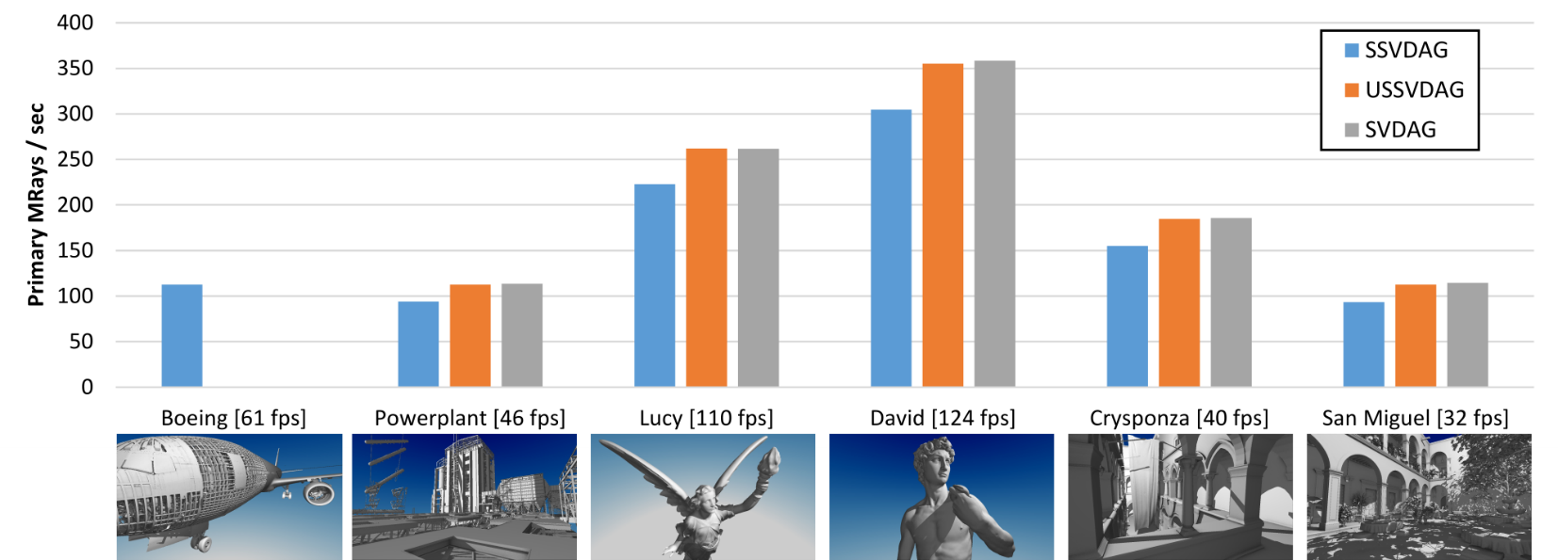
Results – Rendering
GLSL full-stack 3DDDA Raycaster
Symmetries overhead: ~ 1%
Encoding overhead: ~ 15%
720p – Nvidia GTX 980

Slide 33
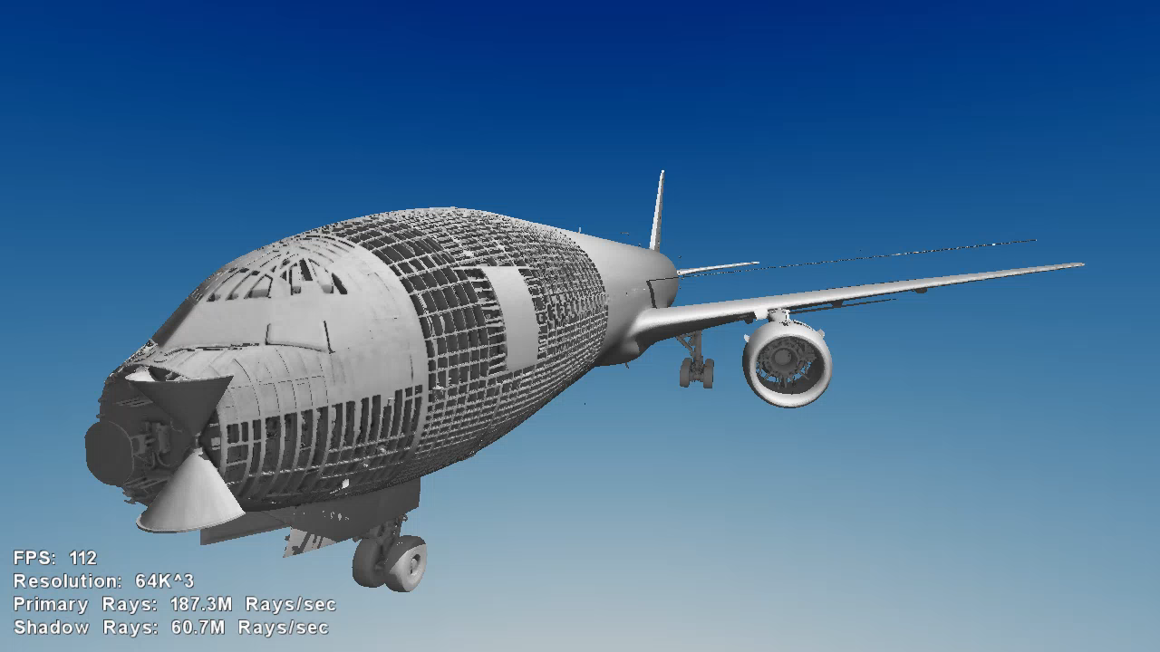

Slide 34
Summary
Efficient lossless encoding of voxelizated geometry
Identical subtrees by a reflection transformation
are stored only once
Node reduction is combined with pointer compaction
by entropy encoding
Probed in a variety of scenes, it achieves
~50% data size reduction respect raw DAGs,
with similar traversal speed
Next problems for next talk!
  How to define a mapping to attributes
  How to compress non-geometric data
  How to render colored models efficiently
Further explanations and source code in JCGT SSVDAGs paper site
http://jcgt.org/published/0006/02/01/

